Slide 1
iNTRO TO data science
Lecture – FSS
Notes:
Chapter #3: Data mining concepts and techniques 3rd edition
https://guhanesvar.medium.com/feature-selection-based-on-mutual-information-gain-for-classification-and-regression-d0f86ea5262a

Slide 2
Outline
Introduction to dimensionality reduction
Feature selection (part I)
Feature extraction (part II)

Slide 3
Why Dimensionality Reduction?
Compared to data preprocessing and analysis, data collection is relatively a simple task
Data is not collected only for data mining (Examples??)
Data accumulates in an unprecedented speed (Examples??)
Data preprocessing is an important part for effective machine learning and data mining
Dimensionality reduction is an effective approach to downsizing data

Slide 4
Why Dimensionality Reduction?
Most machine learning and data mining techniques may not be effective for high-dimensional data
Curse of Dimensionality
Query accuracy and efficiency degrade rapidly as the dimension increases.
The intrinsic dimension may be small.
For example, the number of genes responsible for a certain type of disease may be small.

Slide 5
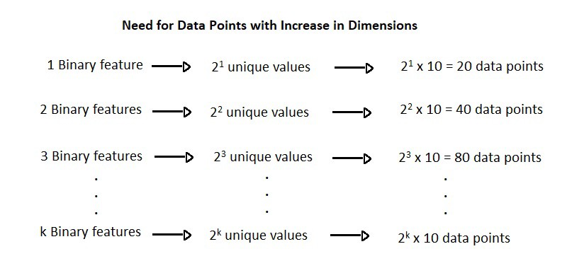

Slide 6
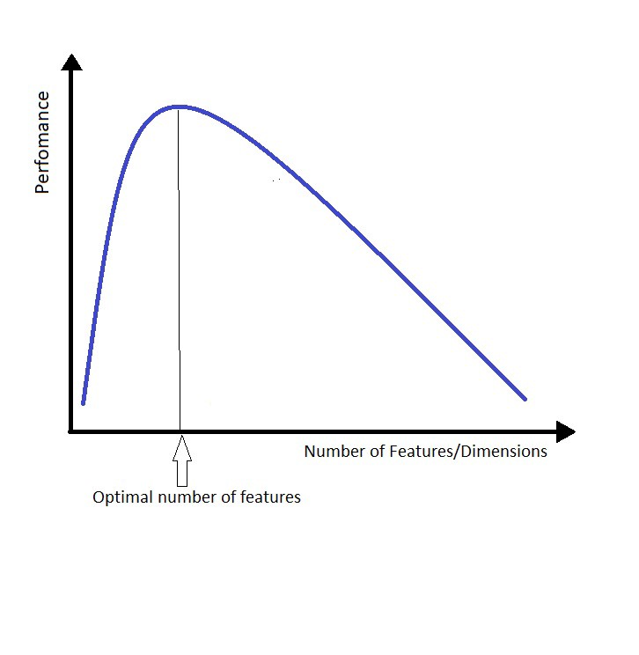
Curse of Dimensionality
Notes:
Hughes (1968) in his study concluded that with a fixed number of training samples, the predictive power of any classifier first increases as the number of dimensions increase, but after a certain value of number of dimensions, the performance deteriorates. Thus, the phenomenon of curse of dimensionality is also known as Hughes phenomenon.

Slide 7
Why Dimensionality Reduction?
Visualization: projection of high-dimensional data onto 2D or 3D.
Data compression: efficient storage and retrieval.
Noise removal: positive effect on query accuracy.

Slide 8
Application of Dimensionality Reduction
Customer relationship management
Text mining
Image retrieval
Microarray data analysis
Protein classification
Face recognition
Handwritten digit recognition
Intrusion detection

Slide 9




Document Classification
Terms
Web Pages
Emails
T₁ T₂ ….…… T_{N}
C
Sports
12 0 ….…… 6
D₁
D₂
Travel
3 10 ….…… 28
Documents
…
…
…
…
D_{M}
0 11 ….…… 16
Jobs
Internet
Task: To classify unlabeled documents into categories
Challenge: thousands of terms
Solution: to apply dimensionality reduction
ACM Portal
IEEE Xplore
PubMed
Digital Libraries
Notes:
Massive volume of data, categories (sports, travel), normally regarded as a bag of words, c is category, classification task, a moderate sized collection of documents, effects of irrelevant and redundant features, feature selection

Slide 10
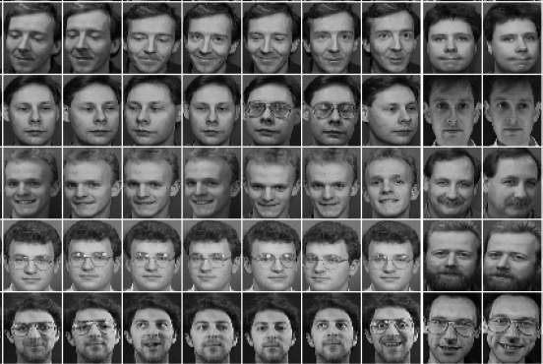
Other Types of High-Dimensional Data
Face images
Handwritten digits

Slide 11
Major Techniques of Dimensionality Reduction
Feature selection
Feature Extraction (reduction)
Differences between the two techniques

Slide 12
Feature Selection
A process that chooses an optimal subset of features according to an objective function
To reduce dimensionality and remove noise
To improve mining performance
Speed of learning
Predictive accuracy
Simplicity and comprehensibility of mined results
Notes:
"objective" is the term used because it is your goal or objective to optimise that function, which could mean maximising something good or minimising something bad, although that difference is trivial,

Slide 13
Feature Extraction
Feature reduction refers to the mapping of the original high-dimensional data onto a lower-dimensional space
Given a set of data points of p variables
Compute their low-dimensional representation:
Criterion for feature reduction can be different based on different problem settings.
Unsupervised setting: minimize the information loss
Supervised setting: maximize the class discrimination

Slide 14
Feature Reduction vs. Feature Selection
Feature reduction
All original features are used
The transformed features are linear combinations of the original features
Feature selection
Only a subset of the original features available are selected

Slide 15
Feature Selection
Feature or Variable Selection refers to the process of selecting features that are used in predicting the target or output. The purpose of Feature Selection is to select the features that contribute the most to output prediction.
Notes:
https://www.analyticsvidhya.com/blog/2022/11/feature-selection-101-the-manual-for-beginners/?relatedposts_hit=1&relatedposts_origin=77639&relatedposts_position=2&relatedposts_hit=1&relatedposts_origin=77639&relatedposts_position=2

Slide 16
Feature Selection
Usually these benefits of Feature Selection are quoted :
Reduces overfitting: Overfitting has been explained in the previous lessons. If the model is overfitting, reducing the number of features is one of the methods to reduce overfitting.
Improves accuracy: Less overfitting would perform well on the unseen dataset, so it ultimately leads to the improved accuracy of the model.
Reduces training time: A smaller number of features means that there will be less data to train and training will be faster.
Notes:
“The objective of variable selection is three-fold: improving the prediction performance of the predictors, providing faster and more cost-effective predictors, and providing a better understanding of the underlying process that generated the data.”

Slide 17
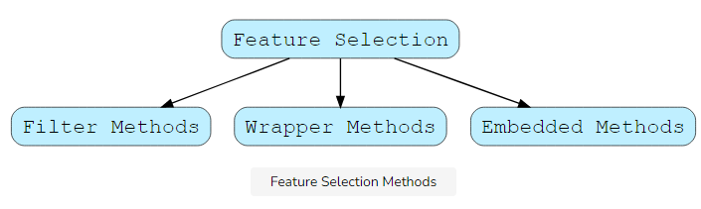
Feature Selection Methods
Feature Selection Methods are categorized into the following methods.

Slide 18
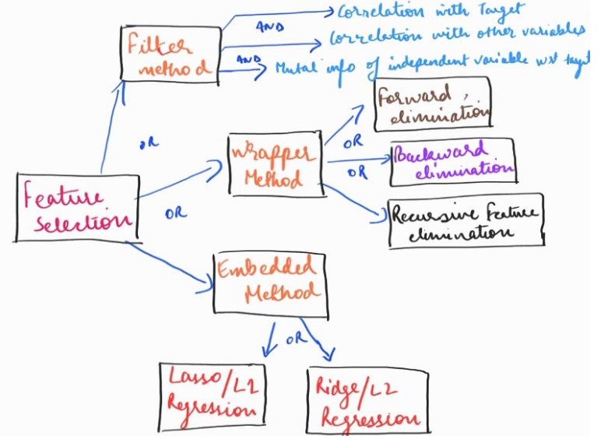
Cont.

Slide 19
1. Filter Method (Feature Selection)
Filter Methods
The Filter Methods involve selecting features based on their various statistical scores with the output column. The selection of features is independent of any Machine Learning algorithm. The rules of thumb are as follows.
The more the features are correlated with the output column or the column to be predicted, the better the performance of the model.
Features should be least correlated with each other. If some of the input features are correlated with some additional input features, this situation is known as Multicollinearity. We recommended getting rid of such a situation for better performance of the model.

Slide 20
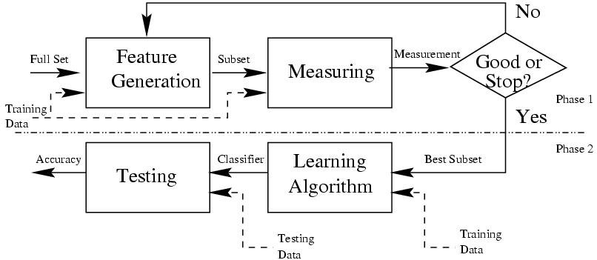
Filter Method

Slide 21
Filter Method
Removing features with low variance(Low variance filter)
VarianceThresold is a simple baseline approach to Feature Selection.
Removes all features whose variance doesn’t meet some threshold.
It involves removing the features having the same value (zero-variance features) in all of their rows or to a specified number of rows. Such features provide no value in building the machine learning predictive model.
Notes:
a statistical measurement of the spread between numbers in a data set.
The only way that a dataset can have a variance of zero is if all of the values in the dataset are the same

Slide 22
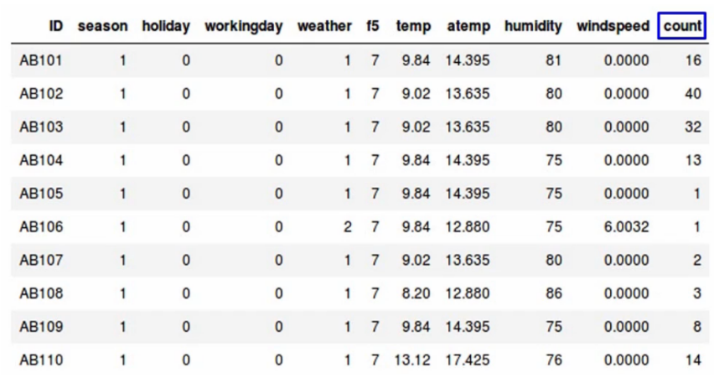
Example: rental bikes predict the count of bikes that have been rented-
Notes:
season - 1 = spring, 2 = summer, 3 = fall, 4 = winter holiday - whether the day is considered a holiday workingday - whether the day is neither a weekend nor holiday weather - 1: Clear, Few clouds, Partly cloudy, Partly cloudy 2: Mist + Cloudy, Mist + Broken clouds, Mist + Few clouds, Mist 3: Light Snow, Light Rain + Thunderstorm + Scattered clouds, Light Rain + Scattered clouds 4: Heavy Rain + Ice Pallets + Thunderstorm + Mist, Snow + Fog temp - temperature in Celsius atemp - "feels like" temperature in Celsius humidity - relative humidity windspeed - wind speed count - number of total rentals

Slide 23
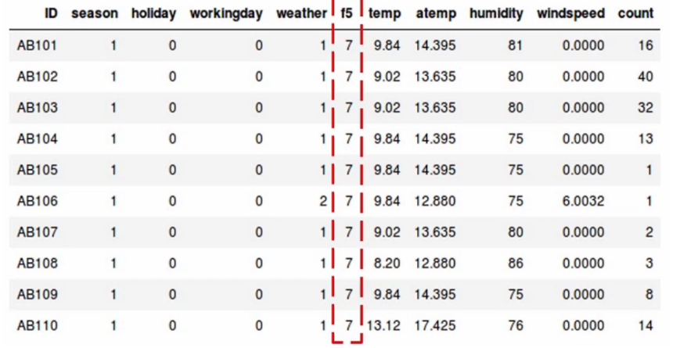
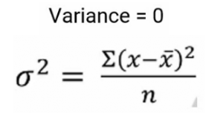
Example contd.
Notes:
Variance tells us about the spread of the data. It tells us how far the points are from the mean.
and the formula to calculate variance is given here-
https://www.analyticsvidhya.com/blog/2021/04/beginners-guide-to-low-variance-filter-and-its-implementation/

Slide 24
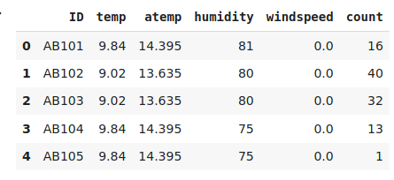
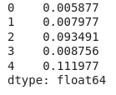
Example: rental bikes
Target variable: count of bikes
Total 6 variables or columns
First drop the ID variable
Apply the low variance filter and try to reduce the dimensionality of the data.
Normalize the data
Compute the variance
Set variance threshold
Select features have Variance greater than set threshold
Threshold>=0.006
Notes:
Normalize the variables because variance is range dependent
As we can see in our dataset, the variables have a pretty high range, which will skew our results

Slide 25
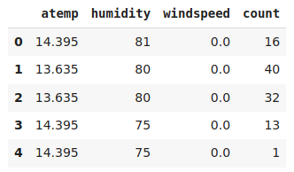

Example: rental bikes

Slide 26
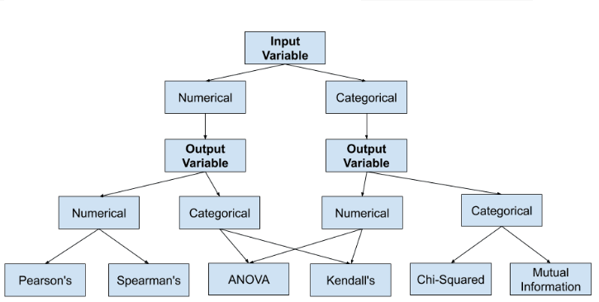
How to choose a feature selection method?

Slide 27
Pearson’s correlation coefficient
In this method you filter and take only the subset of the relevant features. The model is built after selecting the features. The filtering here is done using correlation matrix and it is most commonly done using Pearson correlation and VIF
Pearson Correlation
Pearson correlation is a number between -1 and 1 that indicates the extent to which two variables are linearly related. The Pearson correlation is also known as the “product moment correlation coefficient” (PMCC) or simply “correlation”
Pearson correlations are suitable only for metric variables
The correlation coefficient has values between -1 to 1
A value closer to 0 implies weaker correlation (exact 0 implying no correlation)
A value closer to 1 implies stronger positive correlation
A value closer to -1 implies stronger negative correlation

Slide 28
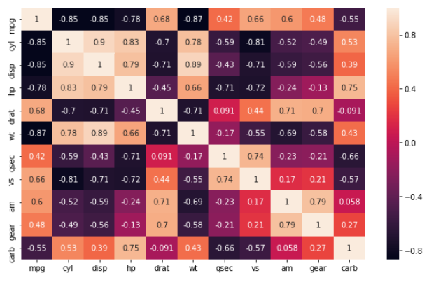
Mpg data set: heat map
Notes:
it is seen that the variables cyl and disp are highly correlated with each other (0.902033). Hence we compared with target varibale where target variable mpg is highly correlated with cyl hence would keep and drop the other. Then we check with other variable same process is followed until last variable. we are left with four features wt,qsec,gear,carb. These are the final features given by Pearson correlation.

Slide 30


Mutual Information
A more robust approach would be to use Mutual Information, which can be thought as the reduction in uncertainty about one random variable given knowledge of another.
Entropy of variable X
Entropy of X after observing Y
Information Gain

Slide 31
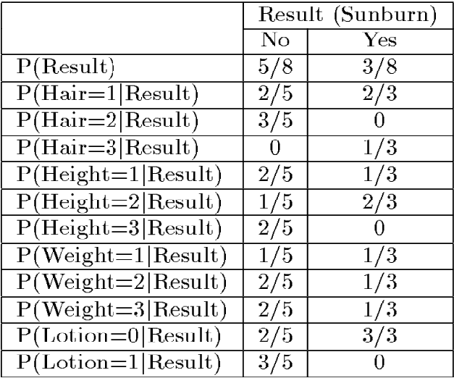
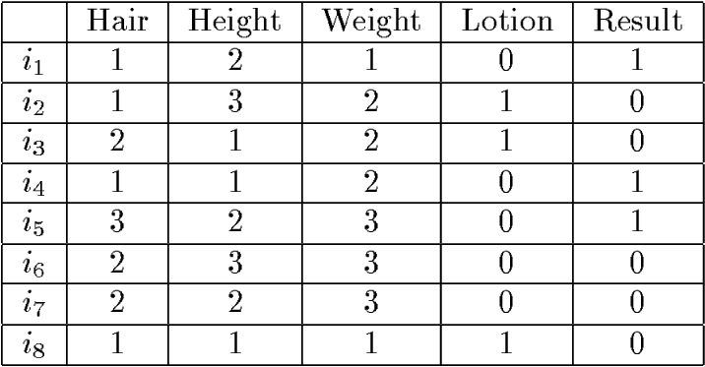
Illustrative Data Set
Sunburn data
Priors and class conditional probabilities
Ex: Which attribute has the highest info gain for the data?

Slide 32
Filter Method
Univariate Selection Methods
Univariate Feature Selection methods selects the best features based on Univariate Statistical tests. Scikit Learn provides the following methods in the Univariate Feature Selection methods.
SelectKBest
SelectPercentile
These two above are the most commonly used methods.
SelectKBest: It gives us the K best features. It takes in two arguments,k which tells how many features to select and score_func which tells us which statistical test to use. The k value can be specified as all, which gives us the score of all input features with the output column.
Score_func: It can be one of the following scoring functions:
1. For regression:f_regression and mutual_info_regression
2. For classification: chi2,f_classif and mutual_info_classif

Slide 33
Feature Selection (Filter Method)
f_regression: It is meant for Regression Problems. It calculates the correlation between each input feature and the output column. It is converted to an F score then to a p-value.
mutual_info_regression: Mutual Information (MI) is the measure of mutual dependence between two variables. It is a non-negative value. If Mutual Information (MI) value is zero, it shows that the variables under consideration are independent. If the Mutual Information (MI) value is high, it shows a high dependence between the variables. This scoring function is meant for Regression Problems only, meaning when the output variable is a continuous-valued output. Mutual Information requires a greater number of samples to better estimate dependence between two variables.
Chi2: It is meant for classification problems. It computes the chi-squared stats χ2 between each non-negative feature and the output categorical variable. Chi-square test measures dependency between variables and helps us exclude the variable that are independent of the target variables.
F_classif: It is the alternative for f_regression in classification problems. It is best recommended for numerical inputs and categorical output.
mutual_info_classif: it is the alternative for mutual_info_regression in classification problems.
It selects features according to a percentile of the highest scores. It takes in two arguments, score_func. The seconf argument is percentile which denotes how many percentiles of features to keep.
Correlation matrix: It simply gives us the pairwise correlation measure between the features.

Slide 34
2. Wrapper Methods (Feature Selection)
Wrapper Methods: In Wrapper Methods the problem of Feature Selection is reduced to a search problem.
A model is built using a set of features and its accuracy is recorded.
Based on the accuracy, more features are added or removed, and the process is repeated.

Slide 35
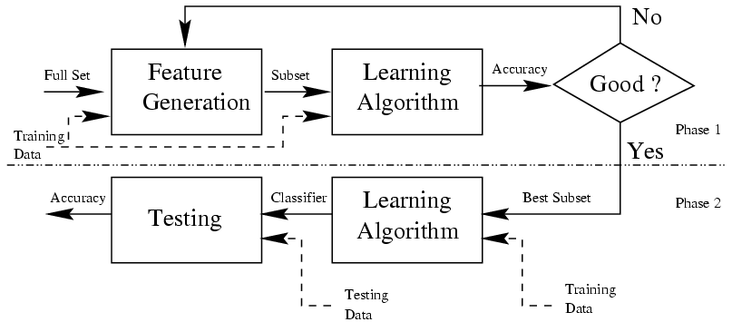
2. Wrapper Methods (Feature Selection)

Slide 36
2. Wrapper Methods (Feature Selection)
We have the following methods in Wrapper Methods.
Forward Selection
Backward Elimination
Exhaustive Search
Recursive Feature Elimination

Slide 37
Feature Selection: Wrapper Methods
A. Forward Selection
Forward Selection is an iterative method.
In this method, we start with one feature and we keep on adding features until no improvement in the model is observed.
The search is stopped after a pre-set criteria is met.
This is a greedy approach because it always targets the features in a forward fashion, which gives a boost to the performance.
If the number of features are large, it can be computationally expensive.
B. Backward Elimination
This process is the opposite of the Forward Selection Method.
It starts initially with all the features and keeps on removing features until no improvement is observed.

Slide 38
Feature Selection : Wrapper Methods
C. Exhaustive Search
This Feature Selection Method tries all the possible combinations of features to select the best model.
This method is quite computationally expensive.
For example, if we have five features, we will be evaluating 2^5 = 3225=32 models before finalizing a model with good accuracy.
D. Recursive Feature Elimination
Recursively Feature Elimination (RFE) involves the following steps:
We train the model on the initial set of features and the importance of each feature is calculated.
In the second iteration, a model is built again using the most important features and excluding the least important features.
These steps are repeated recursively until we are left with the most important features for the problem under consideration.
Scikit learn library provides functions for Recursive Feature Elimination.

Slide 39
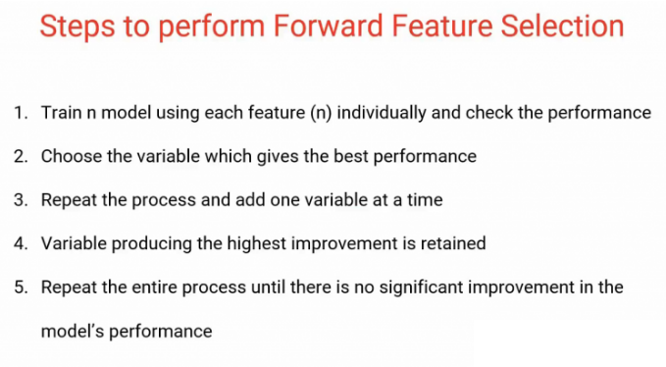
Wrapper method: Forward feature selection

Slide 40
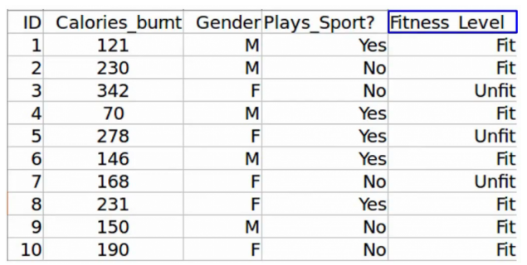
Wrapper based model: forward feature selection
Fitness level prediction
So the first step in Forward Feature Selection is to train n models using each feature individually and checking the performance.
If you have three independent variables, we will train three models using each of these three features individually.

Slide 41
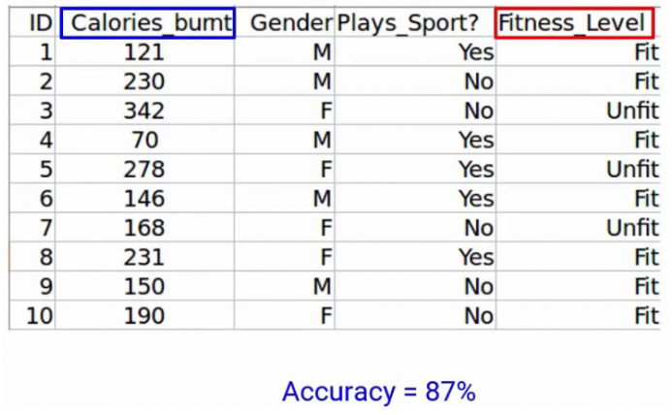
forward feature selection: Example
Let’s say we trained the model using the Calories_Burnt feature and the target variable, Fitness_Level and we’ve got an accuracy of 87%
Notes:
https://www.analyticsvidhya.com/blog/2021/04/forward-feature-selection-and-its-implementation/

Slide 42
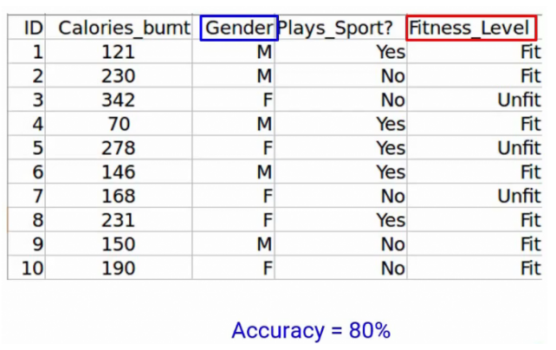
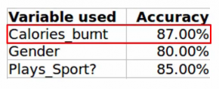
forward feature selection: Example cont.
Next, we’ll train the model using the Gender feature, and we get an accuracy of 80%

Slide 43
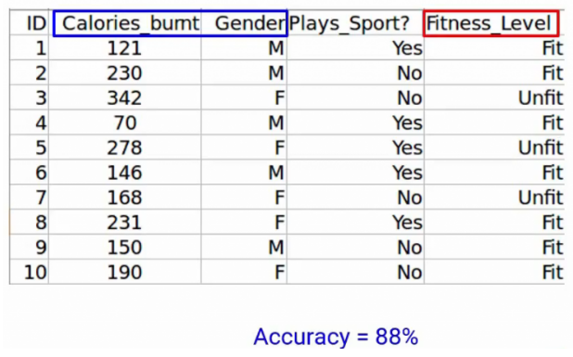
Example cont.
Next, we will repeat this process and add one variable at a time. So of course we’ll keep the Calories_Burnt variable and keep adding one variable. So let’s take Gender here and using this we get an accuracy of 88%-

Slide 44
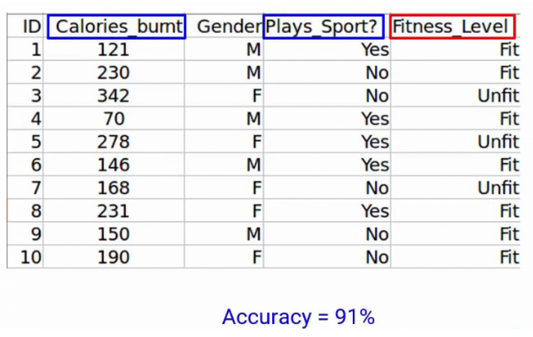
Example cont
Plays_Sport along with Calories_Burnt, we get an accuracy of 91%. A variable that produces the highest improvement will be retained.

Slide 45
Feature Selection (Wrapper model): Backward Feature Elimination
These are our assumptions-
No missing values in the dataset
Variance of the variables is high
Low correlation between the independent variables

Slide 46
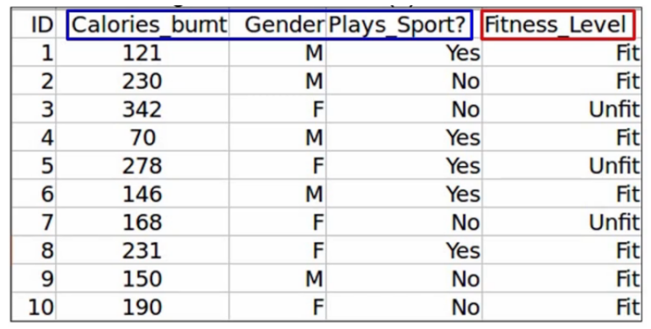
Backward Feature Elimination: Example
Fitness prediction level
The first step is to train the model, using all the variables.
You’ll of course not take the ID variable train the model as ID contains a unique value for each observation
So we’ll first train the model using the other three independent variables. And of course, the target variable, which is the Fitness_Level.
we get an accuracy of 92% using all three independent variables.

Slide 47


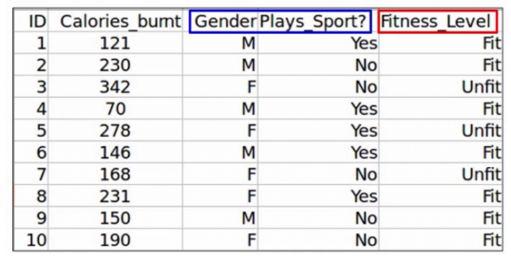
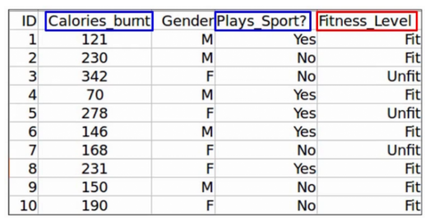

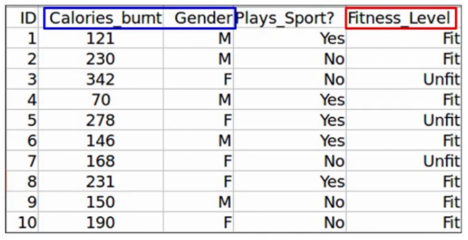

Slide 48
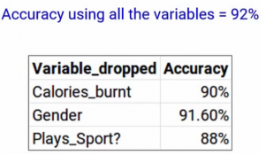
Backward Feature Elimination: Example
If you see gender has produced the smallest change in the performance in the model first, it was 92% when we took all the variables and when we dropped gender, it was 91.6%. So we can infer that gender does not have a high impact on the Fitness_Level variable. And hence it can be dropped.
Finally, we will repeat all these steps until no more variables can be dropped.
It’s a very simple, but very effective technique.

Slide 49
3.intrinsic Methods (Feature Selection)
Intrinsic or Embedded Methods
Embedded methods learn about the features that contribute the most to the model’s performance while the model is being created. You have seen Feature Selection methods in the previous lessons, and we will discuss several more in future lessons, like Decision Tree based methods.
Ridge Regression (L2-Regularization)
Lasso Regression (L1-Regularization)
Elastic-Net Regression (uses both L1 and L2 Regularization)
Decision Tree-Based Methods (Decision Tree Classification, Random Forest Classification, XgBoost Classification, LightGBM).
We know regularization reduces some of the parameters in the equation below to zero. This property of regularization methods can be used as a Feature Selection Method.
y = w_0 + x_1w_1 + x_2w_2 + x_3w_3... +x_nw_ny=w0​+x1​w1​+x2​w2​+x3​w3​...+xn​wn​

Slide 50
Feature extraction (part II)

Slide 51
Principal Component Analysis for Dimensionality Reduction
n this lesson, you'll learn about Principal Component Analysis, which is a famous dimensionality reduction technique to help represent data in lower dimensions which can be helpful in visualizations and modeling.
Principal Component Analysis#
PCA stands for Principal Component Analysis. It helps us transform high-dimensional datasets (having a large number of features) into a low-dimensional one (having a smaller number of features) without losing too much information. These datasets can include images or simple structured datasets. This helps us deal with the curse of dimensionality, which results in complex models and difficulty in visualizing.
Data represented in lower dimensions can be easily visualized. It would also help in modelling as the model won’t have to take into account extraneous features represented in higher dimensions. It also helps us remove the Multi-collinearity situation in which some input features are correlated with each other and provide redundant information.

Slide 52
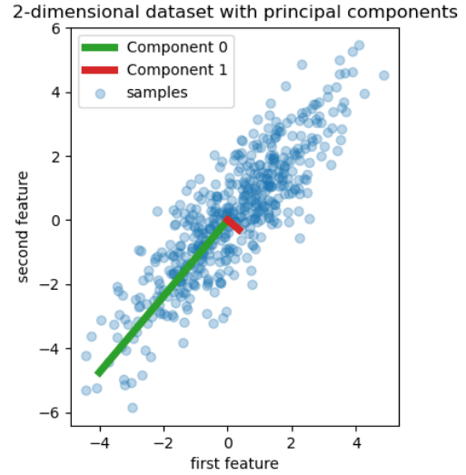

Slide 53
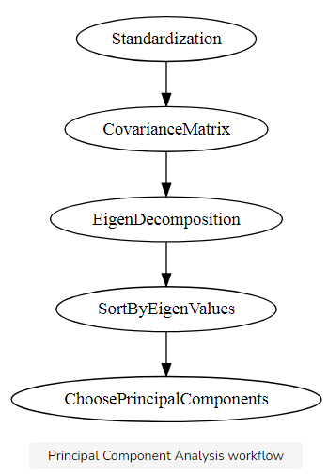
How PCA works?#

Slide 54
How PCA works?#
PCA begins by standardization each column at hand. This helps to standardize the range of continuous variables. If we don’t perform the standardization, the columns with a large range of values will dominate over those having small range of values in the calculations involved in the next steps. The following steps demonstrate standardization is done as follows.
Z=σx−μ​
\muμ is the mean of the respective column and \sigmaσ is the standard deviation of the respective column.
In the second step of Principal Component Analysis, we calculate the Covariance Matrix using the standardized features in the above step. Correlation tells us about how different columns change together positively or negatively. It is a normalized measure. Covariance is a generalized and unnormalized version of Correlation.
In this step, we perform the EigenDecomposition of the Covariance Matrix. This results in producing the EigenValues and the EigenVectors. Eigen-Vectors are also called Principal Components in the context of the topic. The EigenValues are simple values and explain the amount of variance captured in each Principal Component.
Principal Components are constructed as a linear combination of the original features. Principal Components are constructed in such a way that most of the information(the largest possible variance) in the original variables is squeezed in the first component and then to the other components and so on.
We construct a total of nn principal components where nn is the total number of dimensions of the dataset. We sort the Principal Components in order of their EigenValues, highest to lowest, and we get the principal components in order of significance.
In the last step, we decide the number of Principal Components to keep and choose the ones of greater significance and construct a matrix of vectors that we call Feature Vectors. These are our features in the new lower dimensions.

Slide 55
Feature selection
https://machinelearningmastery.com/feature-selection-with-real-and-categorical-data/
https://medium.com/mlearning-ai/feature-selection-using-filter-method-python-implementation-from-scratch-375d86389003

Slide 56
B] Variance Inflation Factor(VIF)
Collinearity is the state where two variables are highly correlated and contain similar information about the variance within a given dataset. To detect collinearity among variables, simply create a correlation matrix and find variables with large absolute values.
Steps for Implementing VIF
Calculate the VIF factors.
Inspect the factors for each predictor variable, if the VIF is between 5–10, multicollinearity is likely present and you should consider dropping the variable.
VIF method selected 3 features disp, vs, am. These are the final features given by VIF.

Slide 57
THAT’S IT FOR TODAY!

Slide 58
Filter Method for Feature selection
The filter method ranks each feature based on some uni-variate metric and then selects the highest-ranking features.
Filter Selection Select independent features with:
No constant Variables
No/less Quadi-constant variables
No Duplicate Rows
High correlation with the target variable
Low correlation with another independent variable
Higher information gain or mutual information of the independent variable.

Slide 59
Advantages of Filter methods
Filter methods are model agnostic(compatible)
Rely entirely on features in the data set
Computationally very fast
Based on different statistical methods
The disadvantage of Filter methods
The filter method looks at individual features for identifying it’s relative importance. A feature may not be useful on its own but may be an important influencer when combined with other features. Filter methods may miss such features.
One thing that should be kept in mind is that the filter method does not remove multicollinearity. So, you must deal with the multicollinearity of features as well before training models for your data.

Slide 60
1. mRMR Score
Selecting an optimal feature subset from a large feature space is considered as an NP complete problem. The
mRMR (Minimum Redundancy and Maximum Relevance) feature selection framework solves this problem by
selecting the relevant features while controlling for the redundancy within the selected features. mRMR feature
selection method is used for different classification problem such as marketing machine learning platform at
Uber that automates creation and deployment of targeting and personalization models at scale
2. MI Score:
Mutual information is a statistic to measure the relatedness between two variables. It provides a general measure
based on the joint probabilities of two variables assuming no underlying relationship such as linearity. Mutual
information is also used in the area of signal processing as a measure of similarity between two signals. Mutual
information is also used in feature selection method for Machine Learning Model.

